Slide 1
TLS
CSE 405 January 2025 - Lecture 7
Special Thanks to Peyrin Kao (UC Berkeley)

Slide 2

TLS
Textbook Chapter 31
Notes:
10 min - 1:50
Introducing crypto!
We’re actually dealing with our problems!
Heads up this is a fairly dense lecture :’))

Slide 3
TLS
TLS (Transport Layer Security): A protocol for creating a secure communication channel over the Internet
Replaces SSL (Secure Sockets Layer), which is an older version of the protocol
TLS is built on top of TCP
Relies upon: Byte stream abstraction between the client and the server
Provides: Byte stream abstraction between the client and the server
The abstraction appears the same to the end client, but TLS provides confidentiality and integrity!
7
Application
4.5
TLS
4
Transport
3
(Inter) Network
2
Link
1
Physical
Notes:
Outdated: security was not built in from the start
We’re adding this into an outdated model
We call this layer 4.5 -> web is built on top of TLS and TLS is built onto the transport layer
Everything that TCP guarantees, we’ll have (reliability, ordering, etc.) since all our packets will be sent over TCP
End-user only really needs to think in terms of connections (5-tuple) -> the actual way that the byte stream is sent is abstracted via TCP
However, we now want to provide confidentiality and integrity!

Slide 4
Today: Secure Internet Communication with TLS
Goals of TLS
Confidentiality: Ensure that attackers cannot read your traffic
Integrity: Ensure that attackers cannot tamper with your traffic
Prevent replay attacks
The attacker records encrypted traffic and then replays it to the server
Example: Replaying a packet that sends “Pay $10 to Mallory”
Authenticity: Make sure you’re talking to the legitimate server
Defend against an attacker impersonating the server
Notes:
TCP had no guarantees for any of these!
Replay attack:
Assume confidentiality/integrity, attacker sees packet (so cannot read or tamper, but writes it down)
Then, resent the exact same packet again -> would the victim accept the message the second time?
Message and MAC would still be valid!
Rinse and repeat!
Authenticity: I make a request to google.com to load these slides -> I would want to be sure I’m talking to the real google.com!
As an end user, want to trust that I’m talking to the legitimate server

Slide 5
TLS Handshake
Textbook Chapter 31
Notes:
15 min - 12:55
Really long handshake… :’))

Slide 6
TLS Handshake Step 1: Exchange Hellos
Client
Server
Assume an underlying TCP connection has already been formed
The client sends ClientHello with
A 256-bit random number RB (“client random”)
A list of supported cryptographic algorithms
The server sends ServerHello with
A 256-bit random number RS (“server random”)
The algorithms to use (chosen from the client’s list)
RB and RS prevent replay attacks
RB and RS are randomly chosen for every handshake
This guarantees that two handshakes will never be exactly identical
ClientHello
ServerHello
Notes:
TCP connection means in TLS, we don’t care about whether the packets are too long or if they’re sent out of order -> abstract that away!
ClientHello: RB, I support (TLS+RSA+AES128+SHA1) or (SSL+RSA+3DES+MD5) or …
ServerHello: RS, Let’s use TLS+RSA+AES128+SHA1
Random numbers ensure that even if we repeat the same handshake with the same people multiple times, at least something is different each time!

Slide 7
TLS Handshake Step 2: Certificate
Client
Server
The server sends its certificate
Recall certificates: The server’s identity and public key, signed by a trusted certificate authority
The client validates the certificate
Verify the signature in the certificate
The client now knows the server’s public key
The client is not yet sure that they are talking to the legitimate server (not an impersonator)
Recall: Certificates are public. Anyone can provide a certificate for anybody
ClientHello
ServerHello
Certificate
Notes:
One of our design goals was to ensure we knew that we were talking to a legitimate server!
Certificate just provides the server’s public key, signed by someone you trust (a trusted certificate authority)
This means that via a hierarchy of trust, because you trust the CA, you now should trust the server
What do you know right now?
Are you guaranteed to be talking to the server?
Repeat this: No… anyone can send a certificate. I can send Taylor Swift’s certificate and as long as you trust the CA who signed it, you’ll trust the public key!
Do you know the server’s public key?`
Yes! You have confident that this is the server’s public key

Slide 8
TLS Handshake Step 3: Premaster Secret
Client
Server
This step has two main purposes
Make sure the client is talking to the legitimate server (not an impersonator)
The server must prove that it owns the private key corresponding to the public key in the certificate
Give the client and server a shared secret
An attacker should not be able to learn the secret
This will help the client and the server secure messages later
ClientHello
ServerHello
Certificate
Notes:
20 min - 1:00
Two purposes of the premaster secret and two ways of doing it…
In previous step, could not guarantee talking to server -> now we want to ensure it (issue a challenge for the server to prove itself)
You know the server’s PK -> that corresponds to an SK -> prove that the server has that SK
You didn’t know if you were talking to the server previously -> this step proves it
Get a shared secret
This is important to so many of our schemes (remember WPA, etc) because symmetric encryption, etc. is usually faster (bit flips versus modular arithmetic)

Slide 9
TLS Handshake Step 3: Premaster Secret (RSA)
Client
Server
The client randomly generates a premaster secret (PS)
The client encrypts PS with the server’s public key and sends it to the server
The client knows the server’s public key from the certificate
The server decrypts the premaster secret
The client and server now share a secret
Recall RSA encryption: Nobody except the legitimate server can decrypt the premaster secret
Proves that the server owns the private key (otherwise, it could not decrypt PS)
ClientHello
ServerHello
Certificate
{PS}Kserver
Notes:
What does it do?
As a client, encrypt a random secret using the server’s public key (from certificate)
Send that encrypted message to the server
The server decrypts it
How does it solve our two goals?
Need to guarantee that we’re talking to the server -> they’re the only one that can decrypt
This is like a challenge!
If you are who you say you are (the legitimate server), you should be able to solve the challenge and decrypt!
An attacker would not have the private key of the server, and thus could not decrypt it
Get a shared secret -> the random value!
Nobody else knows it because nobody else can decrypt it!
Another way of doing this is through Diffie-Hellman. We’re not introducing the next step, but offering a different way to solve our problems.

Slide 10
TLS Handshake Step 3: Premaster Secret (DHE)
Client
Server
The server generates a secret a and computes gª mod p
The server signs gª mod p with its private key and sends the message and signature
The client verifies the signature
Proves that the server owns the private key
The client generates a secret b and computes g^{b} mod p
The client and server now share a premaster secret: g^{ab} mod p
Recall Diffie-Hellman: an attacker cannot compute g^{ab} mod p
ClientHello
ServerHello
Certificate
{gª mod p}K⁻¹server
g^{b} mod p
Notes:
This is an equivalent approach to RSA (we’ll talk later as to which is better).
What does it do?
Canonical DHE
Server sends g^a mod p (signed), client sends g^b mod p
Discrete log problem means knowing g^a mod p and g^b mod p doesn’t give us g^ab mod p
How does it solve our two goals?
Need to guarantee that we’re talking to the server -> they’re the only one that can decrypt
Plain DHE doesn’t guarantee the server is who they say they are (anyone can send g^a mod p)
The signature ensures it!
If Mallory tries to send g^m mod p -> you’re out of luck (doesn’t have the signing key of the server)
Get a shared secret -> g^ab mod p

Slide 11
TLS Handshake Step 4: Derive Symmetric Keys
Client
Server
The server and client each derive symmetric keys from RB, RS, and PS
Usually derived by seeding a PRNG with the three values
Changing any of the values results in different symmetric keys
Four symmetric keys are derived
CB: For encrypting client-to-server messages
CS: For encrypting server-to-client messages
IB: For MACing client-to-server messages
IS: For MACing server-to-client messages
Note: Both client and server know all four keys
{gª mod p}K⁻¹server
g^{b} mod p
Compute keys
Compute keys
Notes:
30 min - 1:10
Now, we know (1) we are talking to the legitimate server and (2) we have a shared secret with the server
Remember that key reuse is bad -> we don’t want to reuse the same key for encrypting and MACing
This happens offline (no one is sending the keys, both client and server are just deriving the four symmetric keys)
Why four? We want to prevent reflection attacks - OOS (attacker takes client->server message and tries to replay it in the server->client direction)
Reflection will be rejected because the HMAC value is incorrect (it will be a HMAC computed with the wrong MAC key).
Security people are typically paranoid
Usually just bring this up because students ask why (but technically two keys would be valid in our course’s approach)
We’ll see that we don’t actually even worry about reflection attacks (since these are actually solved in a later step)
Both client and server know RB, RS, and PS (and they’re the only ones that know PS) -> they’re the only ones that can generate these keys!
Derived keys rely on randomness as well!

Slide 12
TLS Handshake Step 5: Exchange MACs
Client
Server
The server and client exchange MACs on all the messages of the handshake so far
Any tampering on the handshake will be detected thanks to the cryptographic MACs
Not to be confused with MAC addresses
Compute keys
Compute keys
MAC(IB, steps 1-4)
MAC(IS, steps 1-4)
Notes:
Ensure that the handshake has not been tampered with!
We haven’t been sending anything that ensures integrity yet!
Cryptographic MAC, not layer 2 networking MAC addresses

Slide 13
TLS Handshake Step 6: Send Messages
Client
Server
Messages can now be sent securely
Encrypted and MAC’d
Compute keys
Compute keys
MAC(IB, steps 1-4)
MAC(IS, steps 1-4)
{M, MAC(IB, M)}CB
{M, MAC(IS, M)}CS
Notes:
35 min - 1:15
Finally, we can send messages!

Slide 14
TLS: Talking to the Legitimate Server
Client
Server
How can we be sure we are talking to the legitimate server?
The server sent its certificate, so we know the server’s public key
The server proved that it owns the corresponding private key by signing its half of the exchange
An attacker impersonating the server would not have the server’s private key (assuming they have not compromised the server)
ClientHello
ServerHello
Certificate
Certificate
{gª mod p}K⁻¹server
{gª mod p}K⁻¹server
g^{b} mod p
g^{b} mod p
{M, MAC(IB, M)}CB
{M, MAC(IS, M)}CS
Notes:
Walk through entire handshake, pause for questions (then continue through slide)
Now we can check if we actually checked off our design goals
Authenticity: make sure we’re talking to the legitimate server
We got the certificate to know what the server’s public key was!
We challenged the server to prove they were who they said they were

Slide 15
TLS: Replay Attacks
Client
Server
How can we be sure that the attacker hasn’t replayed old messages from a past TLS connection?
Every handshake uses a different RB and RS
The symmetric keys are derived from RB and RS
The symmetric keys are different for every connection
ClientHello
ClientHello
ServerHello
ServerHello
Certificate
{gª mod p}K⁻¹server
g^{b} mod p
{M, MAC(IB, M)}CB
{M, MAC(IB, M)}CB
{M, MAC(IS, M)}CS
{M, MAC(IS, M)}CS
Notes:
Remember we cared about replay attacks in integrity!
What’s a replay attack?
Assume confidentiality/integrity, attacker sees packet (so cannot read or tamper, but writes it down)
Then, resent the exact same packet again -> would the victim accept the message the second time?
Message and MAC would still be valid!
Two types: replay in a past connection, replay in a current connection
Right now, let’s assume we had a TLS connection, then we stopped (sent a FIN TCP packet, etc), and started up a new one.
Randomness is different -> RB and RS
If we use a message from a past connection, the symmetric keys are different (so MACs would fail!)

Slide 16
TLS: Replay Attacks
Client
Server
How can we be sure that the attacker hasn’t replayed old messages from the current TLS connection?
Add record numbers in the encrypted TLS message
Every message uses a unique record number
If the attacker replays a message, the record number will be repeated
TLS record numbers are not TCP sequence numbers
Record numbers are encrypted and used for security
Sequence numbers are unencrypted and used for correctness, in the layer below
ClientHello
ServerHello
Certificate
{gª mod p}K⁻¹server
g^{b} mod p
{M, MAC(IB, M)}CB
{M, MAC(IS, M)}CS
Notes:
Like timestamping messages!
TCP sequence numbers are out in the open (in the header of Layer 4 packet) -> these are used to reassemble/order messages
TLS record numbers are encrypted and thus cannot be seen!
“Pay Mallory $10” at 1:XX… twice? Sus
Kind of like how banks sometimes warn you about duplicate charges (since it’s the same amount of money, at the same time from the same place)
Record numbers are unique (increase by 1)
Msg #161: Pay Mallory $10
Msg #162: Pay Mallory $10 -> this is fine!
Two types of replay attacks!

Slide 17
Forward Secrecy
Textbook Chapter 31.1
Notes:
45 min - 1:25
That’s the full TLS handshake in all its gory detail. Qs? This is definitely one of our densest topics–it’s going to take a couple run throughs to fully digest.

Slide 18
Forward Secrecy
Forward secrecy: If an eavesdropper records an encrypted connection now and learns the secret values later, they cannot decrypt the recorded connection
TLS provides guaranteed forward secrecy, thanks to its use of DHE
Diffie-Hellman provides forward secrecy: PS is deleted after the TLS session is over, so the adversary can’t learn the keys, even if they later obtain the server’s private key
Note: Because the server’s Diffie-Hellman component is signed, the adversary can’t MITM the Diffie-Hellman exchange without the server’s private key
Notes:
Diffie-Hellman itself guaranteed forward secrecy
Forward secrecy: Are you protected from the attacker (in the future) reading messages that they’ve written down in the past if they’ve now gained access to values?
This helps us decide between RSA and DHE
RSA: Attacker writes down RB, RS, and the encrypted PS -> if they later find out the server’s private key, they can decrypt PS and re-derive all the keys that have ever been used for the connections
Problem: Private keys are usually kept for a long time so if you encrypt using RSA, if the server’s private key is compromised, rip
DHE: Doesn’t rely on long-term secrets like RSA does! g^a mod p and g^b mod p don’t tell you what g^ab mod p is
Once we derive g^ab mod p, can destroy a and b (so even if Mallory hacked my laptop, she wouldn’t know what a and b were)
Then, once the session is over, g^ab mod p is also destroyed (and attackers have no hope in learning the symmetric keys for TLS)

Slide 19
TLS 1.3 Changes
TLS 1.3: The latest version of the TLS protocol (2018)
RSA no longer supported (only DHE)
Guarantees forward secrecy
Performance optimization: The client sends g^{b} mod p in ClientHello
If the server agrees to use DHE, the server sends gª mod p (with signature) in ServerHello
Potentially saves two messages later in the handshake
Only supports AEAD mode encryption
Recall AEAD (authenticated encryption with additional data): a block cipher mode that guarantees confidentiality and integrity at the same time
Eliminates attacks associated with the insecure MAC-then-encrypt pattern
Notes:
Forced to use DHE over RSA -> no longer available
Performance optimization: like WPA (remember we’d send the MACs alongside a nonce and the GTK?)
One key for everything -> one algorithm
Used to do MAC-then-encrypt for legacy reasons
Security improvement!

Slide 20
TLS in Practice
Textbook Chapter 31.3
Notes:
50 min - 1:30
We’re done talking about how the protocol really works!

Slide 21
TLS: Efficiency
Public-key cryptography: Minor costs
Client and server must perform Diffie-Hellman key exchange
Symmetric-key cryptography: Effectively free
Modern hardware has dedicated support for symmetric-key cryptography
Performance impact is negligible
Latency: Extra waiting time before the first message
Must perform the entire TLS handshake before sending the first message
Notes:
Handshake has overhead but it’s pretty minor
Every message now has to be encrypted instead of just sending plaintext over TCP
Symmetric-key is so fast: it’s just bit flips!
TLS is such a common protocol, AES, etc. everyone’s using it -> modern hardware is dedicated for that!
Technically slower than TCP, but you’re probably never going to notice it
Latency: in vanilla TCP, need the 3-way handshake (syn, syn-ack, ack), but now in TLS, need to set up entire TCP handshake + everything else

Slide 22
TLS Provides End-to-End Security
TLS provides end-to-end security: Secure communication between the two endpoints, with no need to trust intermediaries
Even if everybody between the client and the server is malicious, TLS provides a secure communication channel -- secure against MITM, on-path attackers, and off-path attackers
End-to-end security does not help if one of the endpoints is malicious (e.g. communicating with a malicious server)
Example: An local network attacker (on-path) tries to read our Wi-Fi session, but can’t read TLS messages
Example: A man-in-the-middle tries to inject TCP packets, but packets will be rejected because the MAC won’t be correct
Using TLS defends against most lower-level network attacks
Notes:
ARP spoofing, DHCP spoofing, BGP MITM -> we mentioned that we just needed to rely on a higher layer
This is that higher layer -> TLS provides end-to-end security
Two things need to be true: client needs to be secure and server needs to be secure (no one can know their secrets)
If this is true, even if everyone in the middle was an attacker, this is a secure channel
How? To derive the preshared secret, you either need to be the client who sent it or someone who has the private key to decrypt (which is just the server)
Even if a MITM wants to be able to read it, they can’t
Doesn’t prevent problems if one of the endpoints is malicious though

Slide 23
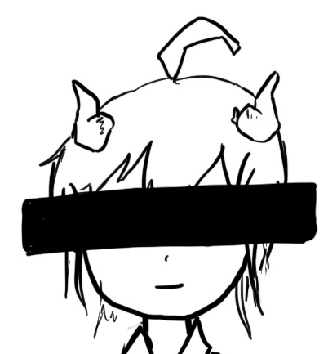
TLS Provides End-to-End Security (RSA)
Client
Man-in-the-middle
Server
ClientHello
ClientHello
ServerHello
Certificate
ServerHello
Certificate
MITM cannot read PS since it’s encrypted with the server’s PK!
{PS}Kserver
{PS}Kserver
Notes:
Even if MITM dutifully forwards messages (doesn’t even tamper), they won’t know the PS, so they don’t know the keys that will be used!

Slide 24
TLS Provides End-to-End Security
Client
Man-in-the-middle
Server
ClientHello
ClientHello
ServerHello
Certificate
ServerHello
{gª mod p}K⁻¹server
Certificate
{gª mod p}K⁻¹server
MITM cannot derive g^{ab} mod p due to the discrete log problem!
g^{b} mod p
g^{b} mod p

Slide 25
TLS Does Not Provide Anonymity
Anonymity: Hiding the client’s and server’s identities from attackers
An eavesdropper can figure out who is communicating
The certificate is sent during the TLS handshake, containing the server’s name
The client may also indicate the name of the server in the ClientHello (called Server Name Indication, or SNI)
An attacker can see IP addresses and ports of the underlying IP and TCP protocols
From: 20:61:84:3a:a9:52
To: 6d:36:ff:4a:32:92
Information here is not confidential!
From: 1.2.3.4
To: 5.6.7.8
From: Port 1234
To: Port 80
Information here is confidential!
Encrypted TLS message,
MAC TLS tag
Notes:
TOR!
Remember that a Layer 3 packet wraps around a Layer 4 packet, etc.
This means that IP addresses/ports are not encrypted
This makes sense because in BGP, etc. routing needs to be able to read without being the end user!

Slide 26
TLS Does Not Provide Availability
Availability: Keeping the connection open in the face of attackers
An attacker can stop a TLS connection
MITM can drop encrypted TLS packets
On-path attacker can still do RST injection to abort the underlying TCP connection
Result: A TLS connection can still be censored
The censor can block TLS connections
Information here is not secure (no cryptography)!
From: Port 1234
To: Port 80
TCP header
Layer 4: TCP
Encrypted TLS message,
MAC TLS tag
TCP data
Encrypted TLS Information
Information here is secure!
Notes:
We’ll talk about this in denial of service
In the layers of abstraction, the TLS encrypted message (with the MAC) is within a TCP packet
This is the data wrapped within a TCP header
Since every secure TLS message is still sent over TCP, TCP header is still vulnerable, so flags are vulnerable (like the RST injection - you inject with the right sequence numbers!)
Flags are not part of the encrypted message

Slide 27
TLS for Applications
Layering: TLS provides services to higher layers (the application layer)
HTTPS: The HTTP protocol run over TLS
In contrast, HTTP runs over plain TCP, with no TLS added
Other secure application-layer protocols besides HTTPS exist
Pretty much anything that runs over TCP can also run over TLS, since the bytestream abstraction is maintained
Example: Email protocol can use the STARTTLS command to uses TLS to secure communications
TLS does not defend against application-layer vulnerabilities
Example: SQL injection, XSS, CSRF, and buffer overflow vulnerabilities in the application are still exploitable over TLS
Notes:
Our Networking unit (which started from the lowest layer) has actually hit our topmost layer, which intersects with our Web unit
Did anyone take 61c with Prof Dan Garcia, where he makes you do the conga when you finally learn the connection between hardware and software components?
We won’t make you do this (i mean your choice if you want to after class - i won’t stop you)
We can build anything over TLS since it guarantees we can send messages from one person to another with cryptographic guarantees
Remember in web, we were discussing abstractly, how you can send a message to someone else? Well, we just finished that–networking allows you to do this!
All HTTP needs is a way to send messages between computers -> you have that, it’s called TLS!
You can build ssh, file transfer protocols, etc -> a lot of different application layer protocols (we only require you to know HTTPS)
XSS:
I can create the most beautiful system with hardcore TLS, but in that encrypted TLS message that’s sent, there can be malicious Javascript that someone stored on my server… whelp
No one can tamper with the payload, but rip
TLS stops networking attacks at lower layers, not application-layer web vulnerabilities. It’s not a one-stop shop.

Slide 28
SSL Stripping Attacks
Browsers sometimes default to using unencrypted HTTP
If a user types google.com into the browser, the browser opens http://www.google.com
To mitigate this, websites will often redirect from the HTTP to the HTTPS version of its site
This requires the client to first receive the unprotected HTTP redirect response
SSL stripping: Forcing a user to use unencrypted HTTP instead of HTTPS
A MITM attacker intercepts the first HTTP request and creates their own HTTPS connection to the server
The user never receives a redirect to HTTPS, so it believes the site wants them to use HTTP
Defense: HTTP Strict-Transport-Security (HSTS) header tells browsers to only access the server with HTTPS
User
HTTP
Attacker
HTTPS
Server
Notes:
Modern computers now try to redirect you to HTTPS (but browsers typically default to unencrypted HTTP - did not design in security from the start)
MITM can intercept HTTP and just serve HTTP to user
Good reminder to actually type out that https:// lowkey, thanks blue slides!

Slide 29


TLS in Browsers
Original design:
When your browser communicates with a server over TLS, your browser displays a lock icon
If TLS is not used, there is no lock icon
What the lock icon means
Communication is encrypted (TLS guarantee)
You are talking to the legitimate server (TLS guarantee)
Any external images or scripts are also fetched over TLS
This website uses HTTP: no lock icon
This website uses HTTPS: lock icon
Notes:
1 hour - 1:40 min
Design problem!
Used to have a lock icon when HTTPS, but nothing when using HTTP
We’re not punishing servers for not using HTTPS
We want to incentivize HTTPS (and thus, TLS)

Slide 30
TLS in Browsers
What users think the lock icon means
This website is trustworthy, no matter where the lock icon actually appears
Attack: The attacker adds their own lock icon somewhere on the page
The user thinks they’re using TLS, but actually is not using TLS
Attack: The user might be communicating with an attacker’s website over TLS
The lock icon appears, but the user is actually vulnerable!
Notes:
Consider human factors
UI Attacks

Slide 31


TLS in Browsers
Modern design: Add a “not secure” icon to connections that don’t use TLS
Adds a signal on unencrypted sites
Encourages websites to stop supporting all unencrypted, HTTP traffic and redirect to HTTPS
This website uses HTTP: insecure icon
This website uses HTTPS: lock icon
Notes:
Nowadays, there’s a “not secure” icon (you get punished if you don’t use TLS)

Slide 32
TLS Attack: PRNG Sabotage
Consider TLS with Diffie-Hellman
An attacker who learns the DHE secret a can derive the PS g^{ab} mod p (recall g^{b} mod p is sent over the channel), and then derive the symmetric keys (recall RC and RS are sent over the channel)
Consider using a PRNG to generate all random values
Includes the server DHE secret a and the client DHE secret b
What if the PRNG is sabotaged and doesn’t have rollback resistance?
Example of sabotage: Dual_EC DRBG with knowledge of the secret used to create the generator
Example of sabotage: ANSI X9.31: An AES-based PRNG with a secret key
Attack: See subsequent PRNG output and work backwards to learn the DHE secret
Notes:
https://blog.cryptographyengineering.com/2017/10/23/attack-of-the-week-duhk/
Bad PRNG = insecure DHE (sad)

Slide 33
TLS Trust Issues: Certificate Authorities
Notes:
1 hr 5 min - 1:45

Slide 34
Certificates in TLS
The server sends its certificate
Certificate: The server’s domain name and public key, signed by a certificate authority
The browser verifies the server’s certificate
The browser checks the domain name in the URL matches the domain name in the certificate
The certificate authority’s public key is hardwired into the browser (trust anchor)
The browser uses the CA’s public key to verify the signature
If the certificate is verified, the browser now knows the server’s public key
Notes:
Networking comes into play regarding who we trust
Ultimately, trust comes from real-life relationships
Certificate has to be signed by someone you trust–but who is that someone that you trust?
All of TLS security relies on who you trust!
That’s a real life problem, not a cryptography problem anymore

Slide 35
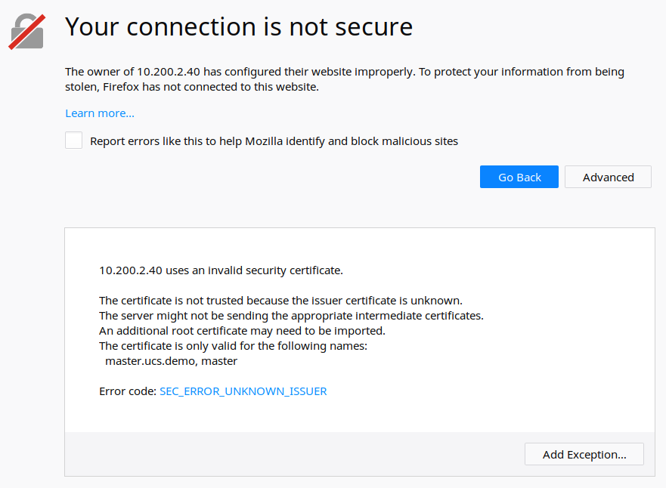
Issues: Unknown Certificate Authority
Notes:
“The certificate is not trusted because the issuer certificate is unknown.
The server might not be sending the appropriate intermediate certificates.
An additional root certificate may need to be imported.”
What if you need to know who to trust? Technically this is warning you that the certificate is not signed by someone you trust. Would you like to be cautious or put your blind faith in it?
Users need to put their blind faith
Typically users will just accept (because they have no idea what this means) -> consider human factors!

Slide 36
Issues: Unknown Certificate Authority
What if the browser doesn’t have the certificate authority’s public key for verification?
Warn the user that the website is not verified
The TLS connection can still proceed, but there is no guarantee that the user is talking to the legitimate server
What if the user is not talking to the legitimate server?
No more end-to-end security
An attacker can read and modify messages
An attacker can impersonate the server

Slide 37
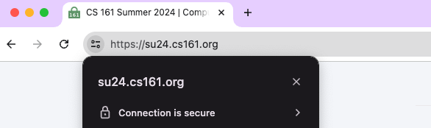
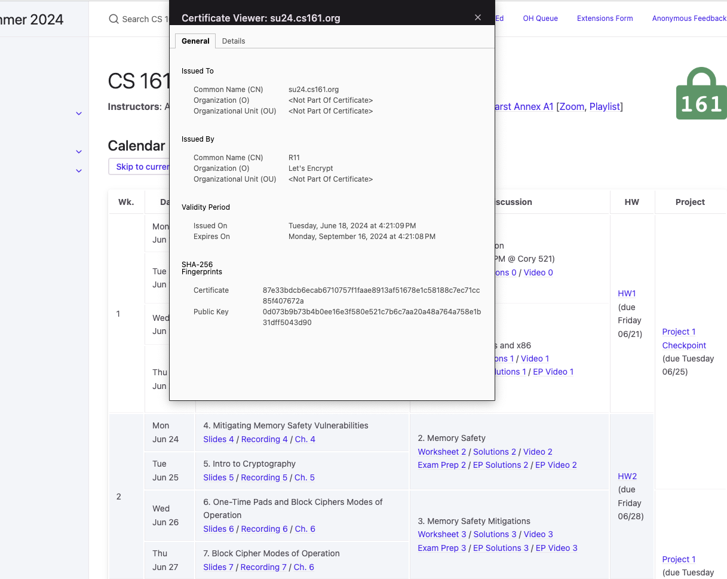
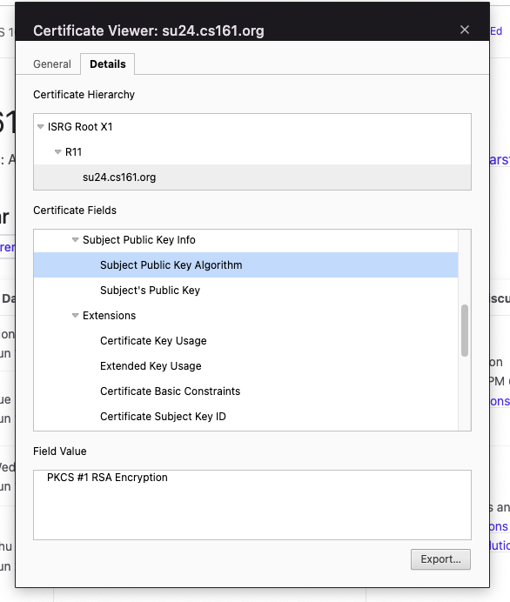
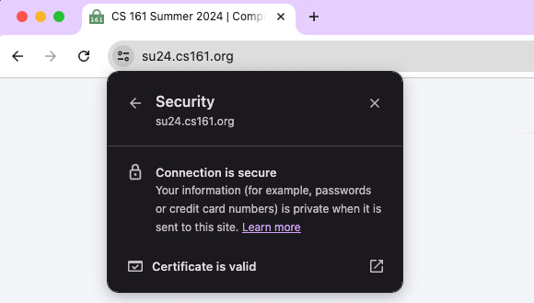
Verifying Certificates
Notes:
Public key provided is used for RSA -> it could say something like DSA (digital signatures algorithm, etc)
CS161 uses Let’s Encrypt (they are the CA that signs our certificate) -> put a bookmark in that for later!

Slide 38
Issues: Revocation
What if an attacker steals a server’s private key?
The certificate with the corresponding public key is no longer valid
TLS certificates have an expiration date, but they often don’t expire for years
Solution: Certificate revocation lists
The CA occasionally sends out lists of certificates that are no longer valid
The browser occasionally downloads the lists
Solution: Online Certificate Status Protocol (OCSP)
The browser queries the CA whether a given certificate is still valid
The CA responds either “good” or “revoked,” signed with the CA’s private key
Notes:
https://en.wikipedia.org/wiki/Online_Certificate_Status_Protocol

Slide 39
Issues: Trust Anchors
How many certificate authorities do we need to implicitly trust?
Modern browsers implicitly trust 100–200 root certificate authorities
A CA might issue a malicious certificate (e.g., stating that attacker’s public key belongs to Google) because:
The CA is hacked
An attacker pays the CA to issue a malicious certificate
Notes:
“Commercial certificate authorities protect you from anyone from whom they are unwilling to take money.” ~Matt Blaze (2001)
“A decade ago, I observed that commercial certificate authorities protect you from anyone from whom they are unwilling to take money. That turns out to be wrong; they don't even do that much.” ~Matt Blaze (2010)
Companies (Verisign), government organizations, non-profits, etc. Do you trust them?
Can be hacked/bribed (has happened before)

Slide 40

Issues: Trust Anchors
 | Link
Solo Iranian hacker takes credit for Comodo certificate attack
Gregg Keizer | March 27, 2011
Security researchers split on whether 'ComodoHacker' is the real deal A solo Iranian hacker on Saturday claimed responsibility for stealing multiple SSL certificates belonging to some of the Web's biggest sites, including Google, Microsoft, Skype and Yahoo. Early reaction from security experts was mixed, with some believing the hacker's claim, while others were dubious.
Takeaway: Trust certificate authorities can be compromised by hackers
Notes:
https://www.computerworld.com/article/2507258/solo-iranian-hacker-takes-credit-for-comodo-certificate-attack.html

Slide 41

Issues: Trust Anchors
 | Link
Fraudulent Google certificate points to Internet attack
Elinor Mills | August 29, 2011
Is Iran behind a fraudulent Google.com digital certificate? The situation is similar to one that happened in March in which spoofed certificates were traced back to Iran. A Dutch company appears to have issued a digital certificate for Google.com to someone other than Google, who may be using it to try to re-direct traffic of users based in Iran. Yesterday, someone reported on a Google support site that when attempting to log in to Gmail the browser issued a warning for the digital certificate used as proof that the site is legitimate, according to this thread on a Google support forum site.
Takeaway: Trust certificate authorities can be compromised by hackers
Notes:
https://www.cnet.com/news/fraudulent-google-certificate-points-to-internet-attack/

Slide 42

Issues: Trust Anchors
 | Link
Final Report on DigiNotar Hack Shows Total Compromise of CA Servers
Dennis Fisher | October 31, 2012
The attacker who penetrated the Dutch CA DigiNotar last year had complete control of all eight of the company’s certificate-issuing servers during the operation and he may also have issued some rogue certificates that have not yet been identified.
Takeaway: Trust certificate authorities can be compromised by hackers
Notes:
https://threatpost.com/final-report-diginotar-hack-shows-total-compromise-ca-servers-103112/77170/

Slide 43

Issues: Trust Anchors
 | Link
Evidence Suggests DigiNotar, Who Issued Fraudulent Google Certificate, Was Hacked Years Ago
Mike Masnick | August 30, 2011
The big news in the security world, obviously, is the fact that a fraudulent Google certificate made its way out into the wild, apparently targeting internet users in Iran. The Dutch company DigiNotar has put out a statement saying that it discovered a breach back on July 19th during a security audit, and that fraudulent certificates were generated for "several dozen" websites. The only one known to have gotten out into the wild is the Google one.
Takeaway: Trust certificate authorities can be compromised by hackers
Notes:
https://www.techdirt.com/articles/20110830/13243615741/evidence-suggests-diginotar-who-issued-fraudulent-google-certificate-was-hacked-years-ago.shtml

Slide 44
Issues: Trust Anchors
DigiNotar: A certificate authority that was hacked
All web browsers removed DigiNotar from the list of trusted CAs
Takeaway: It is hard to implicitly trust the root CAs (trust anchors) in TLS
Takeaway: TLS CA ecosystem is largely secured through human relationships
CAs are motivated to be good because browser vendors can remove them from the list of trusted root CAs at any time (if they’ve been deemed to be bad)
Notes:
“Death sentence for CAs”
“And a bunch of other shady shenanigans”

Slide 45
Mitigating Trust Issues
Certificate pinning: The browser restricts which CAs are allowed to issue a certificate for each website
Example: Only Google's favorite CA is allowed to sign certificates for Google websites
Now creating a fake certificate for a specific website requires attacking a particular CA
Certificate transparency: Public logs provided by CAs
Specifics are out of scope
High-level idea: Use hash chains to keep a record of all issued certificates
The server can tell the browser to only accept certificates from CAs implementing transparency
If CA issues a bad certificate, this is detectable from the public logs
Notes:
Certificate transparency: keep a log of all the certificates they’ve ever issues on a hash chain
All CAs that use this have to tell everyone what they sign for!

Slide 46
Certificate Authority Example: Let’s Encrypt
TLS requires every website to obtain and maintain certificates
Cost overhead: Certificates might cost money
Some management overhead involved
Let’s Encrypt: The world’s largest certificate authority
Issues certificates for free
Tries to make obtaining certificates as easy as possible
Steps of issuing a certificate (can all be automated with a script)
The server requests a certificate
Let’s Encrypt gives the server a file and tells the server to upload the file
The server uploads the file to the website
Let’s Encrypt verifies that the file has appeared on the website (thus verifying the server’s identity) and issues the certificate to the server
Notes:
TLS certificates are literally free now (the cost of TLS is a certificate)
CS161 uses Let’s Encrypt!
They are free! Organized by non-profits (don’t want people to have to make the decision between a tradeoff of money or security)
You now have no reason to not use TLS on your web services – it’s literally free.

Slide 47
TLS: Summary
Client
Server
TLS Handshake
Nonces make every handshake different (prevents replay attacks across connections)
Certificate proves server’s public key
DHE proves that the server owns the private key
DHE helps client and server agree on a shared secret key
MACs ensure no one tampered with the handshake
Messages are sent with symmetric encryption and MACs
Record numbers prevent replay attacks within a connection
ClientHello
ServerHello
Certificate
{gª mod p}K⁻¹server
g^{b} mod p
{M, MAC(IB, M)}CB
{M, MAC(IS, M)}CS

Slide 48
TLS: Summary
Security properties
Forward secrecy (thanks to DHE)
End-to-end security: Secure even if all intermediate hops are malicious
Not anonymous: Attackers can determine who you’re talking to
No availability: Connections can be dropped or censored
Can be used by the application layer (e.g., HTTPS)
Trusting certificate authorities can be hard

